Slide 1
Risk Analysis
Code Suisse Hackathon 2018
BY: Yussef Guerrab and Adithya kasali
Team Name: Wolfpack squad

Slide 2
Project objective
Given multiple csv files that represent security stock prices with their respective dates, analyze that data to:
Allow the user to prompt what security information they would like to view
Time Series Graph showing changes in prices over a user-defined date range
Display the Value-At-Risk for each of the values in the csv file for the same date range
Histogram Graph showing daily returns vs frequency for the same date range

Slide 3
Design
DashboardManager.class : Class that contains the main method
FileParser.class: Parse through the csv file and analyze info and store in a List<RowInfo>
RowInfo.class: Constructor class that contains the parsed csv information
HistogramMaker.class: Given a map<Integer, Integer>, plot a histogram
Operations.class: Performs the calculations for VaR and populating map object (above)
TimeSeriesMaker.class: Makes the time series graph given parameters (start date, end date, List<RowInfo>, etc)

Slide 4
Design Cont.
Three Packages:
Manager Package:
Main Method and allows for user interaction
Calculates Value-At-Risk values and daily returns and frequencies
IO Package:
Reads in input file and parses data into data structure
Graphics Package:
Plots time series graph
Plots histogram

Slide 5
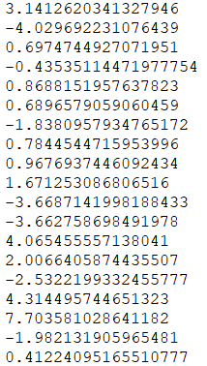
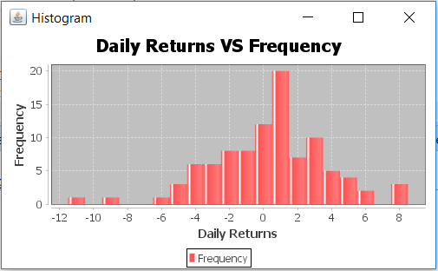
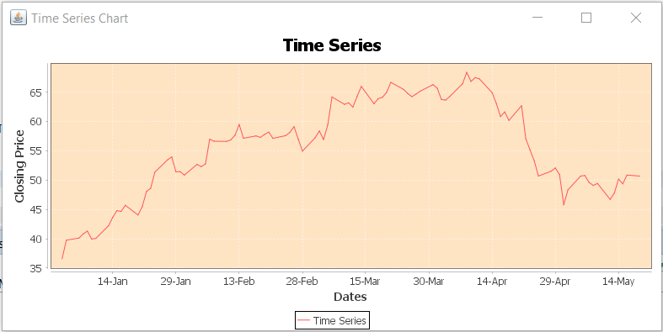
Output example
Note: The output slightly differs from users using different operating systems. This example here is depicting the output for a Windows 10 user.
There is a list of the Value-At-Risk values printed out that the user can see (as shown)

Slide 6
DEMO
Pray this doesn’t crash ☺

Slide 7
Any Questions?

